Slide 1


STUDENT ENGAGEMENT
Department of Mechanical Engineering
McMaster University
Developed by the On-Line Teaching Committee
Elizabeth Hassan
Marilyn Lightstone
Eu-Gene Ng
Gregory Wohl
0:00

Slide 2
DO THIS
Use frequent simple quizzes to keep students up to date on material
Maintain regular office hours where students can chat with you live
Encourage student collaboration and student run study groups
0:12

Slide 3
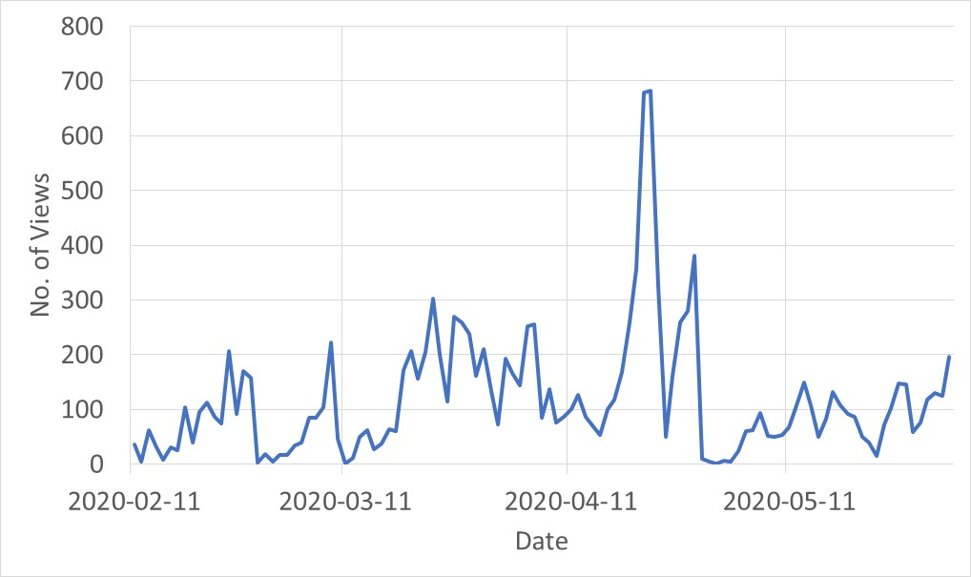
Access of recorded content for synchronous and Asynchronous on-line course delivery
On-line class starts
Asynchronous to 300 students
Synchronous to 100 students
ME 3A03 Exam
ME 3A03 Test 2
ME 3C03 Exam
ME 3A03 Weekly Quiz
ME 3C03 Test 2
ME 3A03 and ME 3C03 Upload recorded lecture
No. of views denote number of times the content has been accessed. Data is sampled daily.
The courses were: MECHENG 3A03 [150 students], MECHENG 3C03 [90 students] and ENGTECH 3ML3 [60 students]
1:24

Slide 4
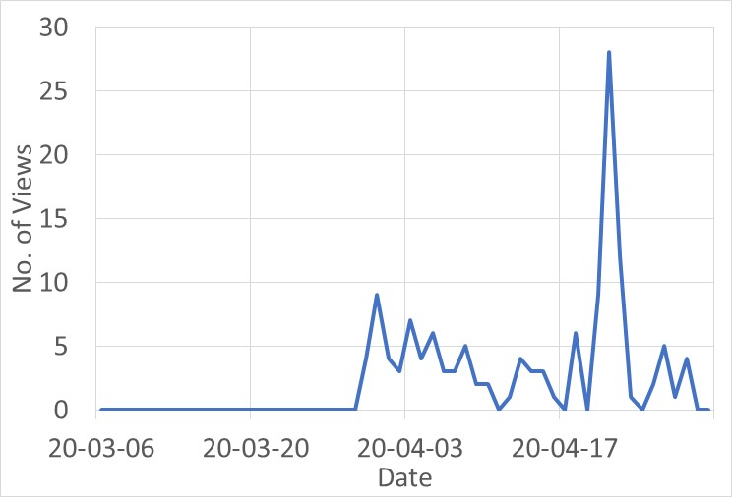
Asynchronous delivery without Quiz [MECHENG 3A03, Buckling]
When no quizzes are in placed, the learner will not watch the content or leave till the very last minute to understand the topic.
Instructor designed learning outcome has not been met :(
6:52

Slide 5
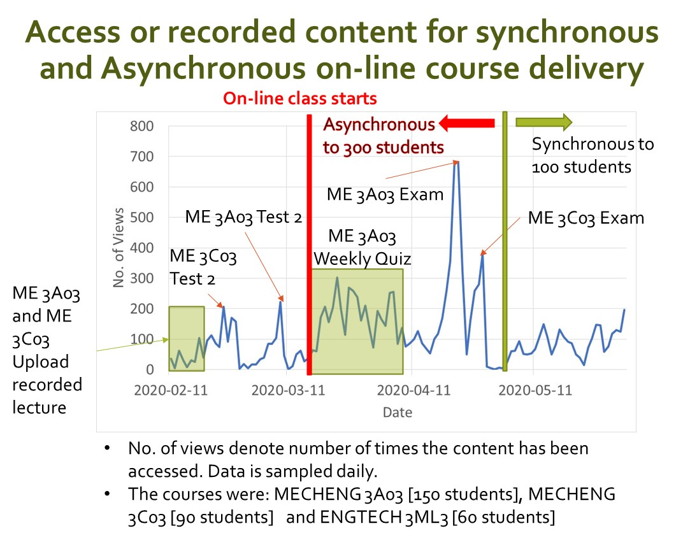
WHAT DID INSTRUCTOR LEARN FROM THIS?
Asynchronous on-line lecture
  Weekly quiz is important to help student "on top" of the material.
  No. of views increased substantially during on-line or off site exams.
  When viewing is low, this means that student are busy with other courses assignments or term tests.
  STUDENTS are overwhelmed with on-line learning ……………
What will I do different now?
  Have Live synchronous lecture or at least Live tutorial session.
  Increase the weightage of the quizzes so that student will learn the content earlier up to 30%......
9:09

Slide 6
DO THIS
Give students sense that there is a human being on the other end
Create notes that students can fill in
Use Webcam when possible so students can see a face
Reply to students quickly so they are not left in the dark
29:45

Slide 7
Demonstration
Human being is on the other end of the computer
Workstation setup for on-line Synchronous course delivery.
32:04

Slide 8


DON’T DO THIS
Make Live Lecture attendance mandatory – students may not have consistent internet access
Just post your notes online without any discussion or presentation
Add quizzes on top of a lot of other assessments for the sake of engagement
Ignore student emails or fail to attend live office hours
35:38

Slide 9
Demonstration
Organizing Avenue to Learn Content for uploading recorded videos and lecture notes.
MECHENG 3A03, Spring/Summer term assessment
  Delivery mode: 90% Live Lecture or Synchronous, 10% Watch recorded content or Asynchronous
  Assessment:
    Assignment: 0%
    Weekly Quizzes: 30% (Quiz questions will be picked from Assignments)
    Term Test: 30%
    Final Exam 40%
41:39

Slide 10
DON’T DO THIS
Make content more difficult or increase work
Use technology that those with low bandwidth cannot reliably access
Use sites other than Avenue for course organization – students are less likely to keep up when they have to go to external sites
48:07

Slide 11
ADDITIONAL TIPS
Create groups in Avenue or Teams to encourage collaboration without needing to know their peers
Delegate email responses to specific TAs to respond to student questions faster, also can delegate them to oversee group work
Create consistent file names between videos and their accompanying notes
Scaffold group projects using a series of deliverables to prevent group work stress and conflicts

Slide 12
ADDITIONAL TIPS
Students are extremely overwhelmed, remember this and be flexible in interactions with students
Be cautious with difficulty of quizzes created for engagement – especially if many other classes are using quizzes, also consider giving occasional “freebies”
Realize its extremely difficult for students to be on the computer 40+ hrs/ week, be mindful how much time these students can allocate online

Slide 13
ADDITIONAL TIPS
Profs – try to keep webcam on. However, let students know they can turn their camera off
Coordinate with other professors to stagger assessments

